Slide 1
SPC 4 ENVIRONMENT PROTECTION, CLIMATE ACTION & ENERGY
FRIDAY 25TH JUNE, 2021.

Slide 2
CASUAL TRADING BYE-LAWS 2021
REVIEW OF CASUAL TRADING BYE-LAWS FOR THE ADMINISTRATIVE AREA OF THE MUNICIPAL DISTRICTS OF :-
CASTLECOMER
CALLAN THOMASTOWN
PILTOWN

Slide 3
EXISTING CASUAL TRADING BAYS
BYE-LAWS 2002
MUNICPAL DISTRICT OF CALLAN / THOMASTOWN
Location No. of Bays
GRAIGUENAMANAGH 15
BOAT SLIP AREA
MILL STREET 1
THOMASTOWN
INISTIOGE 1
HUGGINSTOWN 1
KELLS 1

Slide 4
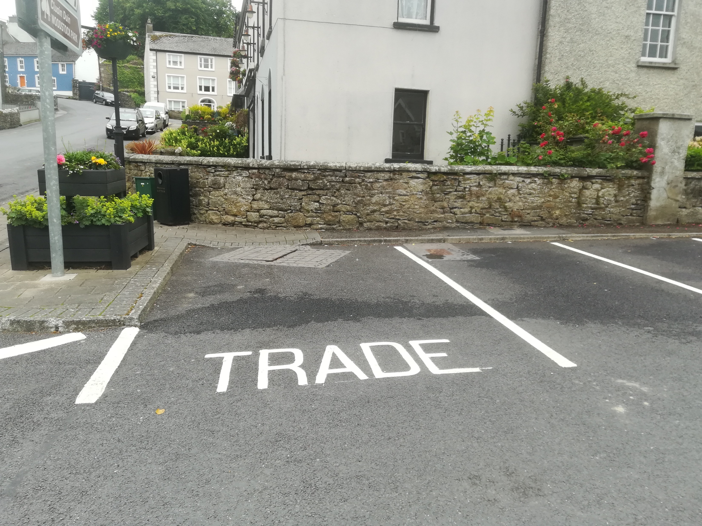
INISTIOGE CASUAL TRADING BAY

Slide 5
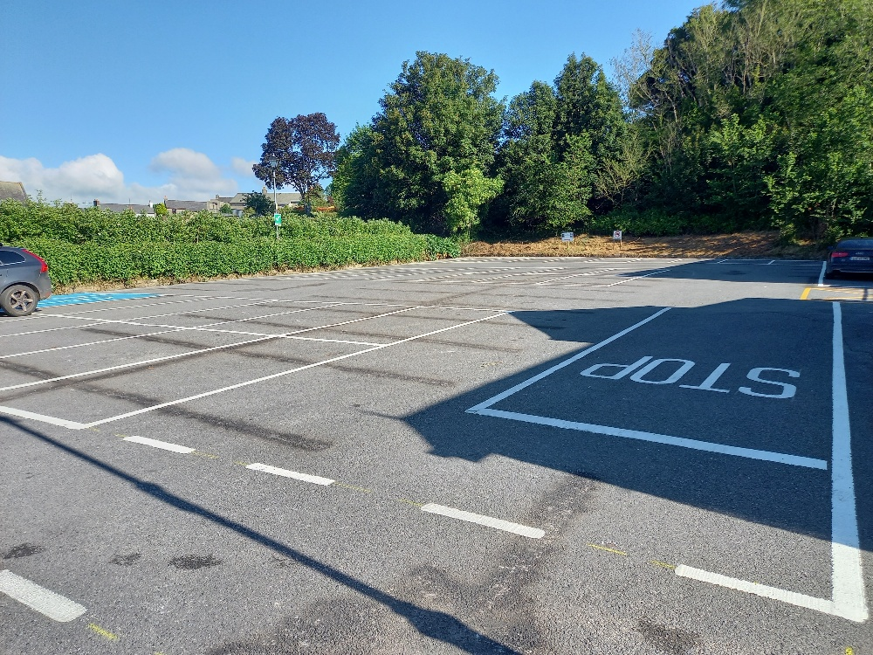
GRAIGUENAMANAGH
BOAT HOUSE
CARPARK

Slide 6
EXISTING CASUAL TRADING BAYS
BYE-LAWS 2002
MUNICPAL DISTRICT OF CASTLECOMER
Location No. of Bays
CASTLECOMER 4
THE SQUARE
KILMANAGH 1
CALLAN RD
GOWRAN 1
FAIRGREEN

Slide 7
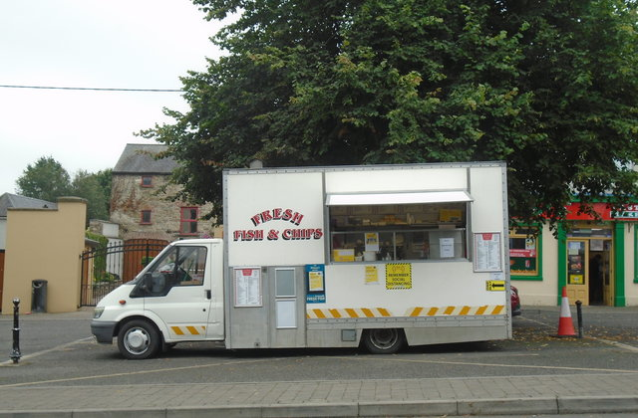
CASTLECOMER
CASUAL
TRADING BAY

Slide 8
EXISTING CASUAL TRADING BAYS
BYE-LAWS 2002
MUNICPAL DISTRICT OF PILTOWN
Location No. of Bays
GLENMORE 1
LAY-BY OPPOSITE
CHURCH CARPARK

Slide 9
CASUAL TRADING LICENCE FEES
CURRENT FEES
€500 per annum for trading 1 day per week
€125 for each additional days casual trading per week
€1250 maximum fee Casual Trading Licence
€25 per day for specified event in casual trading area

Slide 10
LEGISLATION
CASUAL TRADING ACT 1995
PART 19, SECTION 198 – 201
LOCAL GOVERNMENT ACT 2001
S.I. No. 362/2006 REGULATIONS

Slide 11
REVIEW
PROCESS
CONSULTATION WITH ELECTED MEMBERS OF MUNICIPAL DISTRICTS OF CASTLECOMER, THOMASTOWN/CALLAN AND PILTOWN
CONSIDERATION OF FEES, SUITABLE LOCATIONS AND SAFETY OF PROPOSED TRADING BAYS
PREPARATION OF DRAFT BYE-LAWS

Slide 12
REVIEW PROCESS
CONSULT WITH SOLICITORS AND GARDAI
ELECTED MEMBERS APPROVE DRAFT BYE-LAWS FOR PUBLICATION
ADVERTISE DRAFT BYE-LAWS
ALLOW TIME FOR SUBMISSIONS

Slide 13
REVIEW PROCESS
REPORT WILL BE PREPARED ON SUBMISSIONS RECEIVED FOR CONSIDERATION BY ELECTED MEMBERS
ELECTED MEMBERS APPROVE OR AMEND BYE-LAWS
BYE-LAWS ADOPTED

Slide 14
REVIEW PROCESS
CASUAL TRADING BYE-LAWS 2021
BYE-LAWS COME INTO FORCE 30 DAYS AFTER ADOPTION BY ELECTED MEMBERS
APPROVAL OF THE MINISTER FOR HOUSING, PLANNING AND LOCAL GOVERNMENT MAY BE REQUIRED ALSO

Slide 15
TIMELINE
FOR
REVIEW
PROCESS
SEPTEMBER – MEMBERS APPROVE DRAFT
OCTOBER – ADVERTISE DRAFT BYE LAWS
NOVEMBER – CONSIDER SUBMISSIONS PREPARE REPORT FOR MEMBERS
NOVEMBER – MEMBERS APPROVE OR AMEND BYE-LAWS
DECEMBER – BYE-LAWS COME INTO FORCE 30 DAYS AFTER ADOPTION BY ELECTED MEMBERS

Slide 16
CASUAL TRADING BYE-LAWS
2021
QUESTIONS
THANK YOU

