Slide 1
Kilkenny Civil Defence
15/02/2021

Slide 2
Primary Function to be Emergency Ready
support to:
Extreme weather response- transport/evacuation
Welfare provision
Responding to Community Call
Distribution of warning notices
Flood supports
Water rescue
River and open land search/rescue
First aid
Transport during weather events-Medical/staff/Equipment
Additional Medical support at major incidents

Slide 3
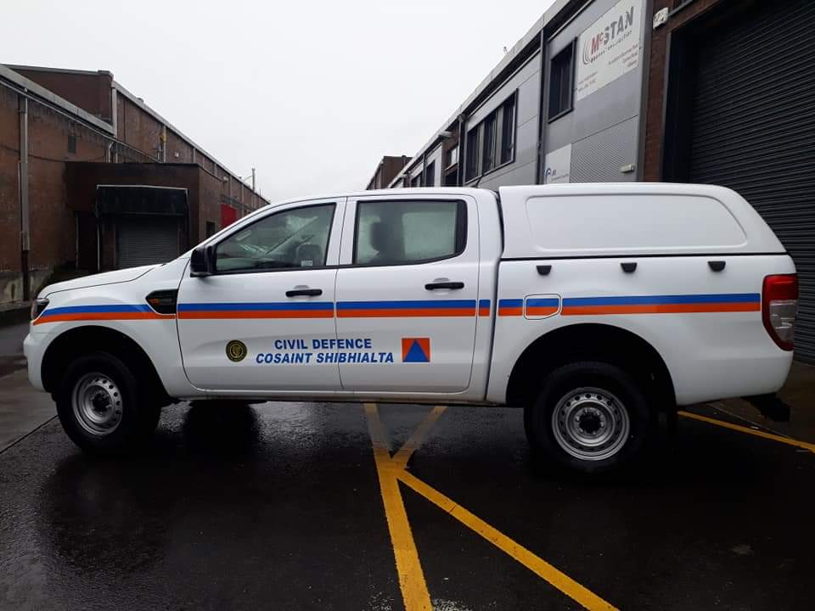
Main Areas of Response/Training
Transport
- Training - Vehicles
-Role in the Major Emergency Plan
Severe weather driving
Advanced severe weather driving
Winch operator
C1 driving – Ambulance
ADI –Driving Instructor
4x4 jeeps | 4
Ambulances | 2
Minibus | 1
Communications control van | 1
Welfare van | 1
Transport | Council staff for emergency repairs
4 wheel drives | Patient/staff transfer to and from hospitals
 | Emergency provision drop off
 | Displaced persons to emergency accommodation
2 New Ford Rangers 2019/2020

Slide 4
Casualty Response -Training - Role in Major Emergency Plan
First Aid Responder
Emergency First Responder
Emergency Medical Technician
Paramedic - External
Casualty 1st Aid Support | Provide 2 ambulances for transport of patients
 | Provide medics up to Paramedic level
 | Provide emergency medical equipment
Search & Rescue
-Training - Role in Major Emergency Plan
Water Awareness
Personal Survival Techniques
National Powerboat Certificate 1/2/3 Swift water and flood rescue boat certificate
Powerboat Instructor
Search and Rescue | Open Country search for missing persons
 | Water based search for missing persons
 | Flood water rescue from buildings
Swift Water Responder
Open Country Search Responder
Search Manager
Communications
2 Rib crafts & 1 rigid Craft
1 inflatable craft
Under water sonar & camera
Fully Fitted Communications Vehicle
-Equipment

Slide 5
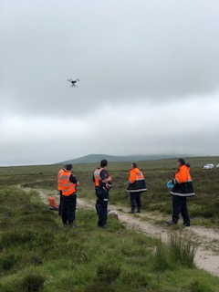
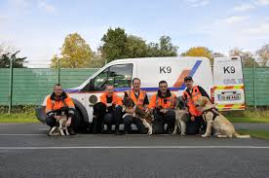
Flood Response
-Training - Role in Major Emergency Plan
Swift Water Responder
Ropes/raft rescue
Flood Pump Operator
Welfare
Flood Response | Pumping of flood waters
 | Swift Water Rescue from flooded areas
 | Sand bag drop off and sandbagging for vulnerable occupants
 | Filling Sand bags
 | Transport evacuation
 | Support LA housing staff with rest center set up and equipment
 | Provide temporary welfare to staff
Inflatable raft
Water Pump
Inflatable Marquee
-Equipment
Other Regional Supports Available
Drones
Dogs

Slide 6
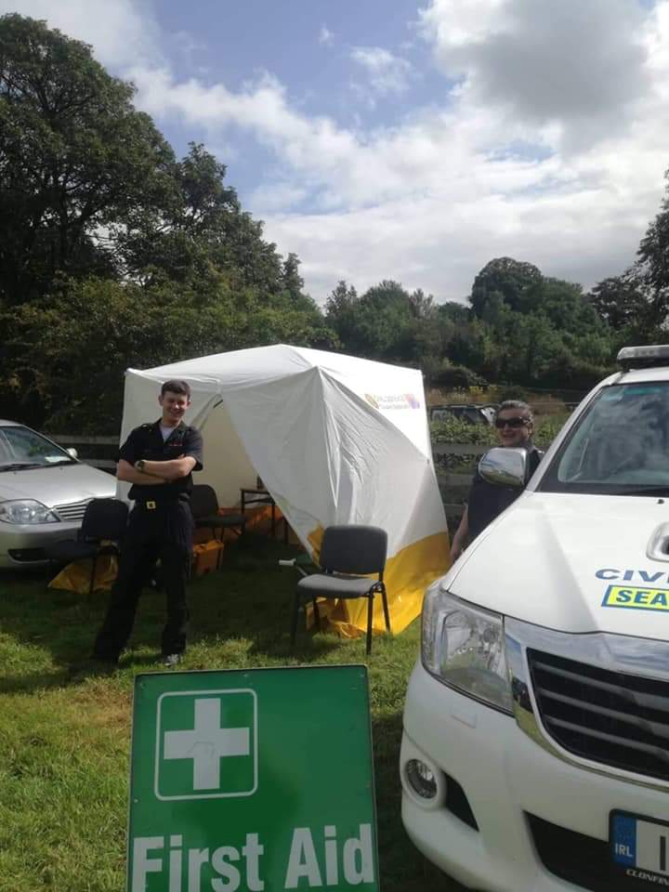
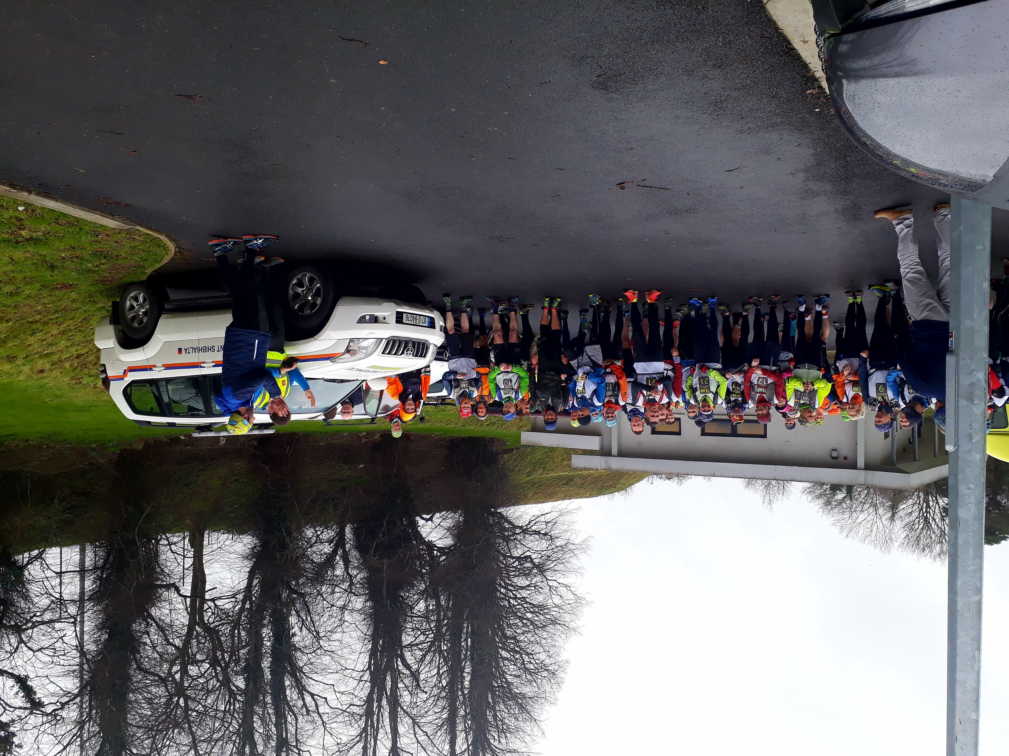
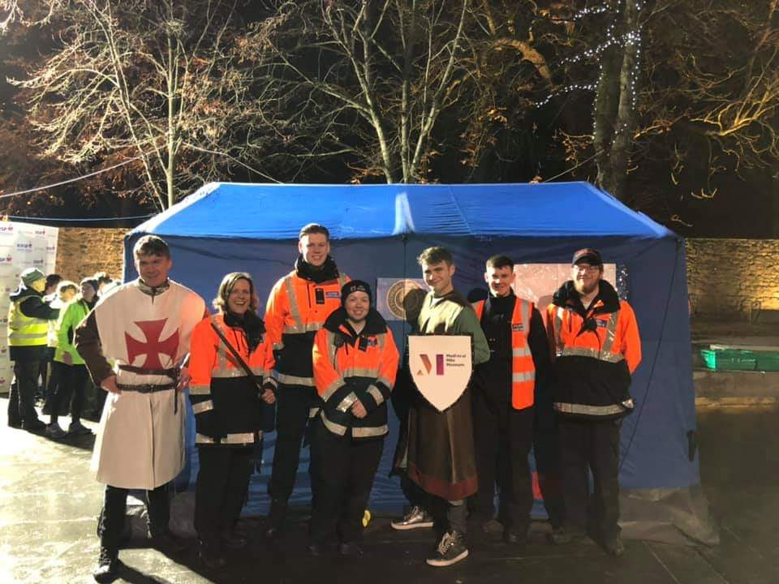
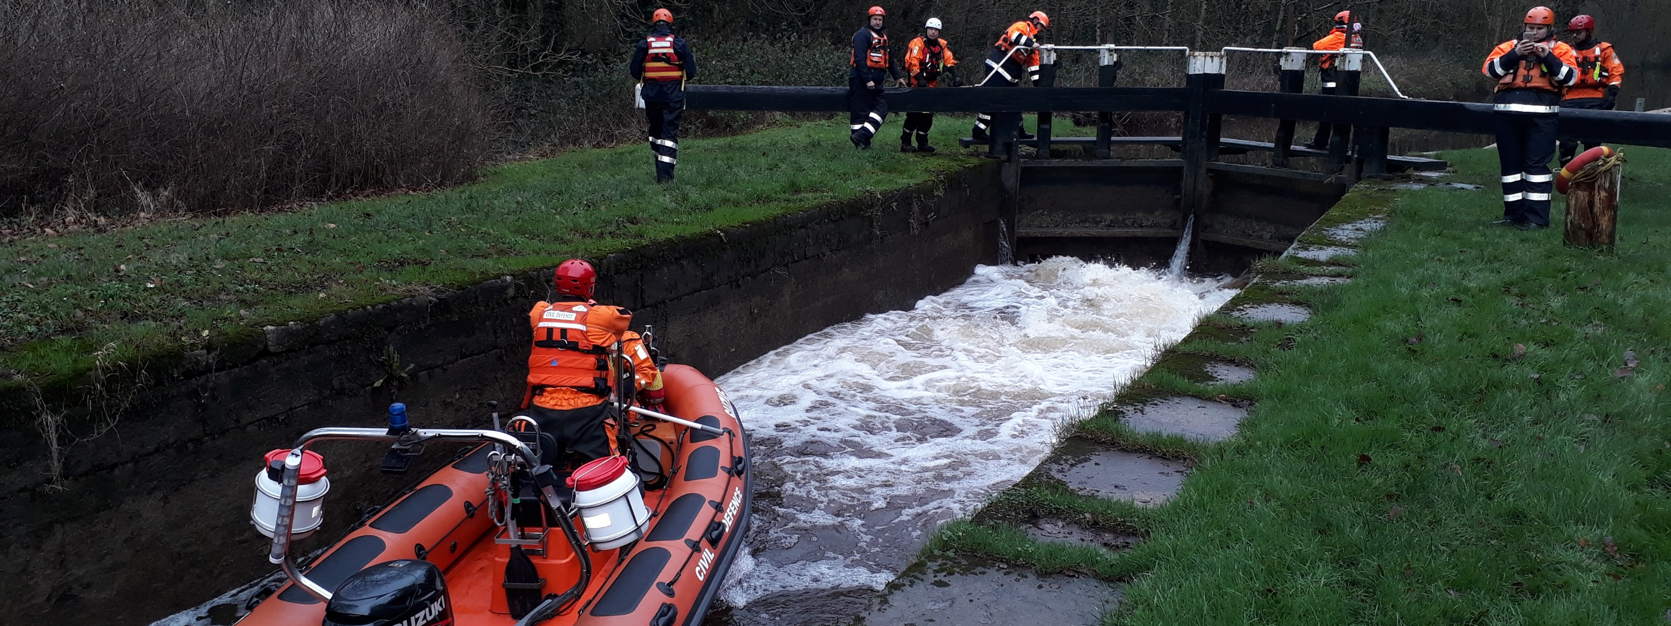
Community Engagement
Maintain Skills through community duties and continuous training
Sporting events
Charity Events
Community Fetes
Water based activity
Average pre covid – 35 duties PA

Slide 7
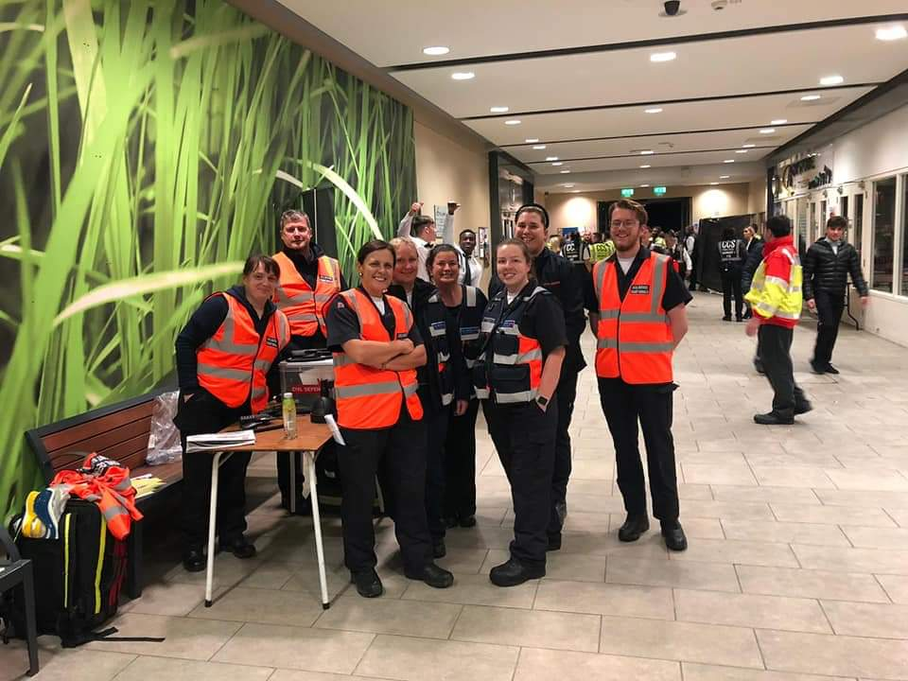
Volunteers
July 2018- 7 volunteers-post fire
Feb 2021- 34 (waiting List)
July 2022 – 50 volunteers
Training
Weekly – 1 evening
weekend courses
9 instructors various disciplines
2020- 12 Certified Courses
100 certificates
Governance/Oversight
LA overall responsibility
CDO reports directly to DoS
Dept of Def. – role in policy/training
CDO:
Chair of SE Regional VES working grp
Member of the SE ME Working
Group with the PRA’s

Slide 8
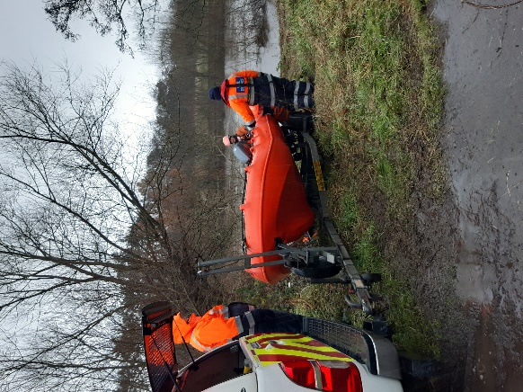
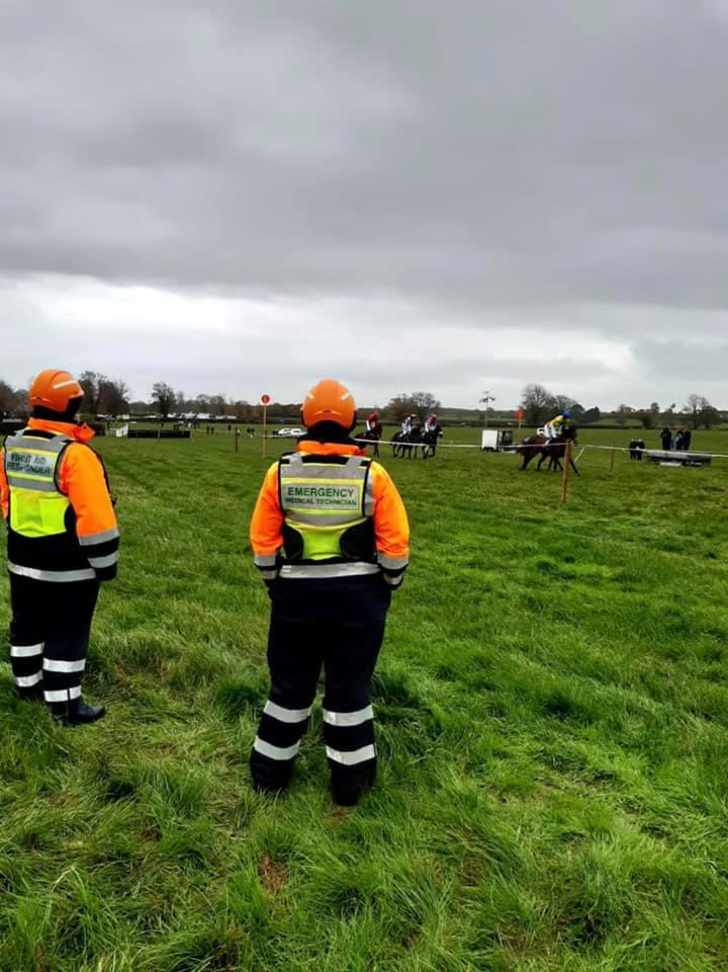
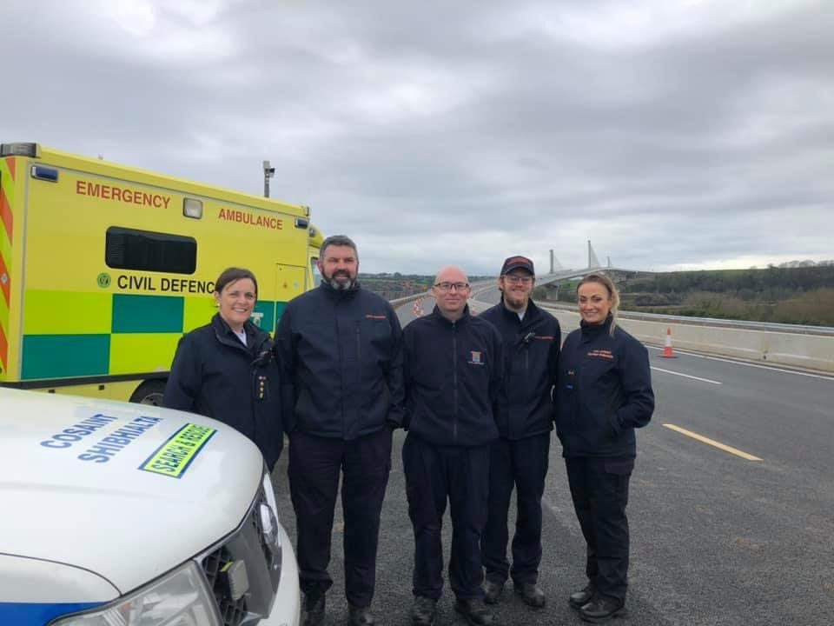
2020 – Response
February: Month long search – 300 man hours
Duties | Number | Hours
Covid | 350 | 2112
Community Events | 11 | 236
Search | 2 | 310
Total | 363 | 2668
Covid Response March- Dec
Community events

Slide 9
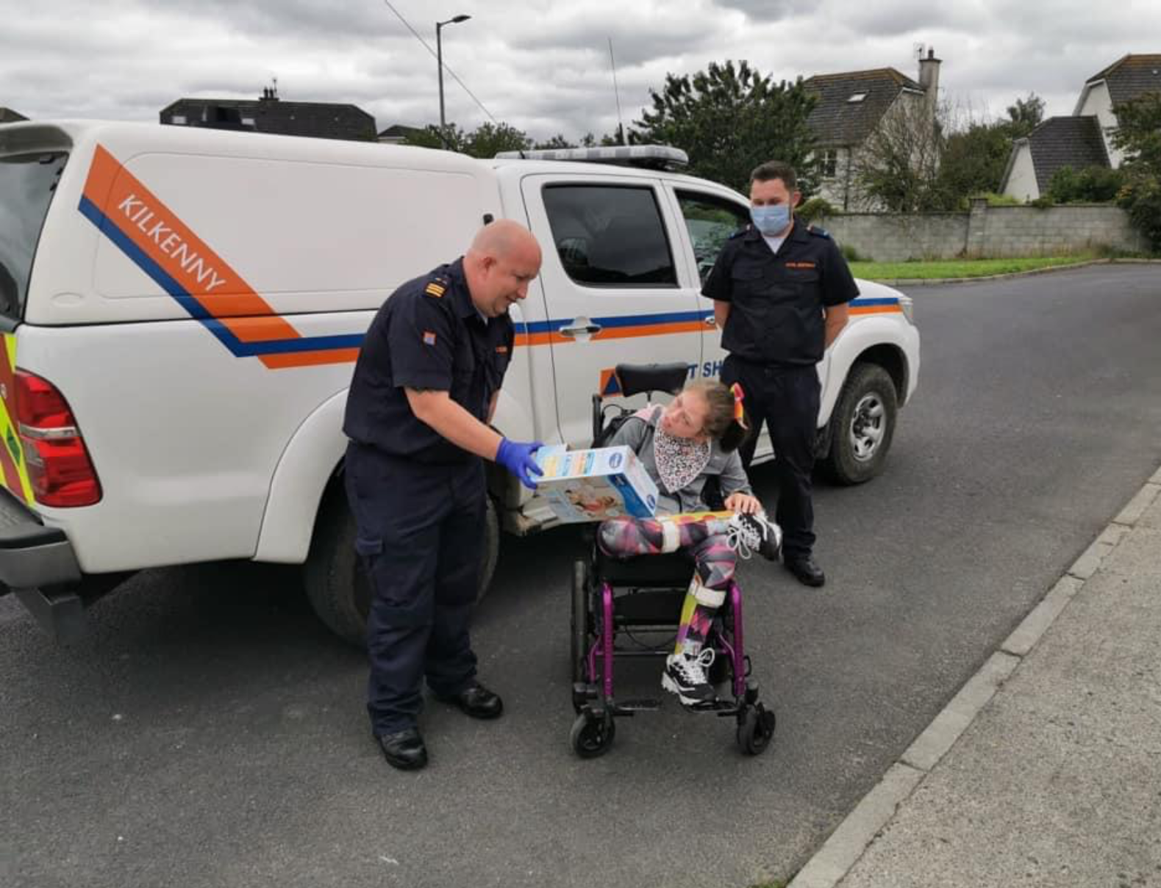
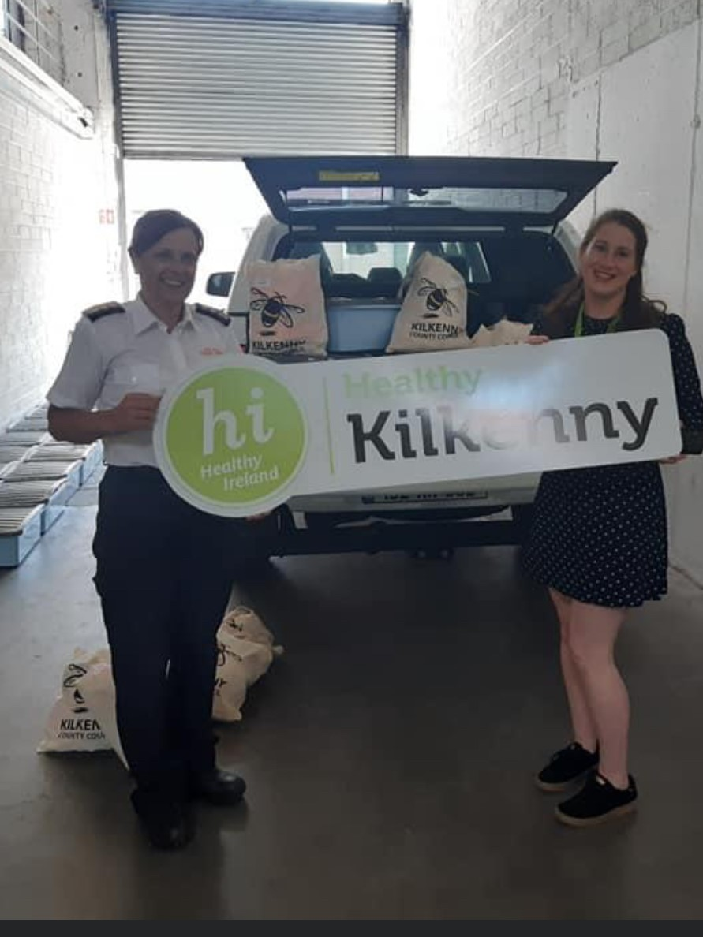
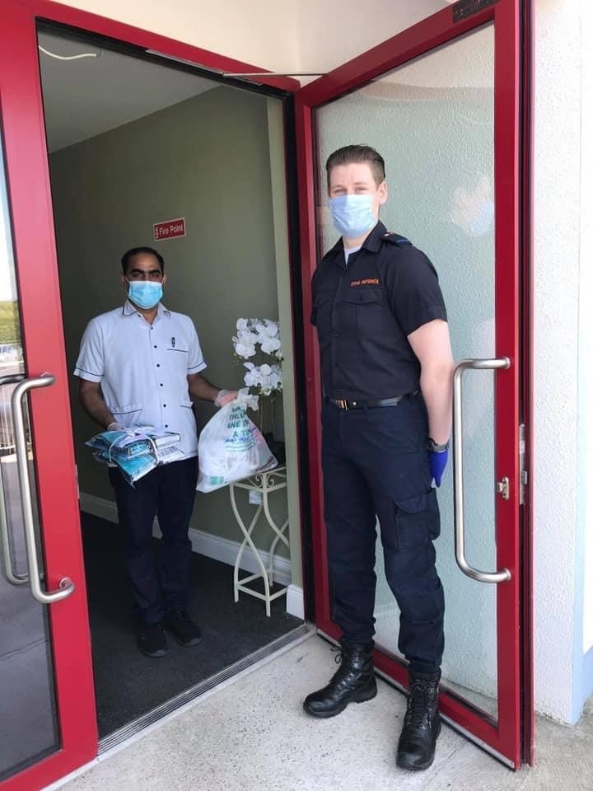
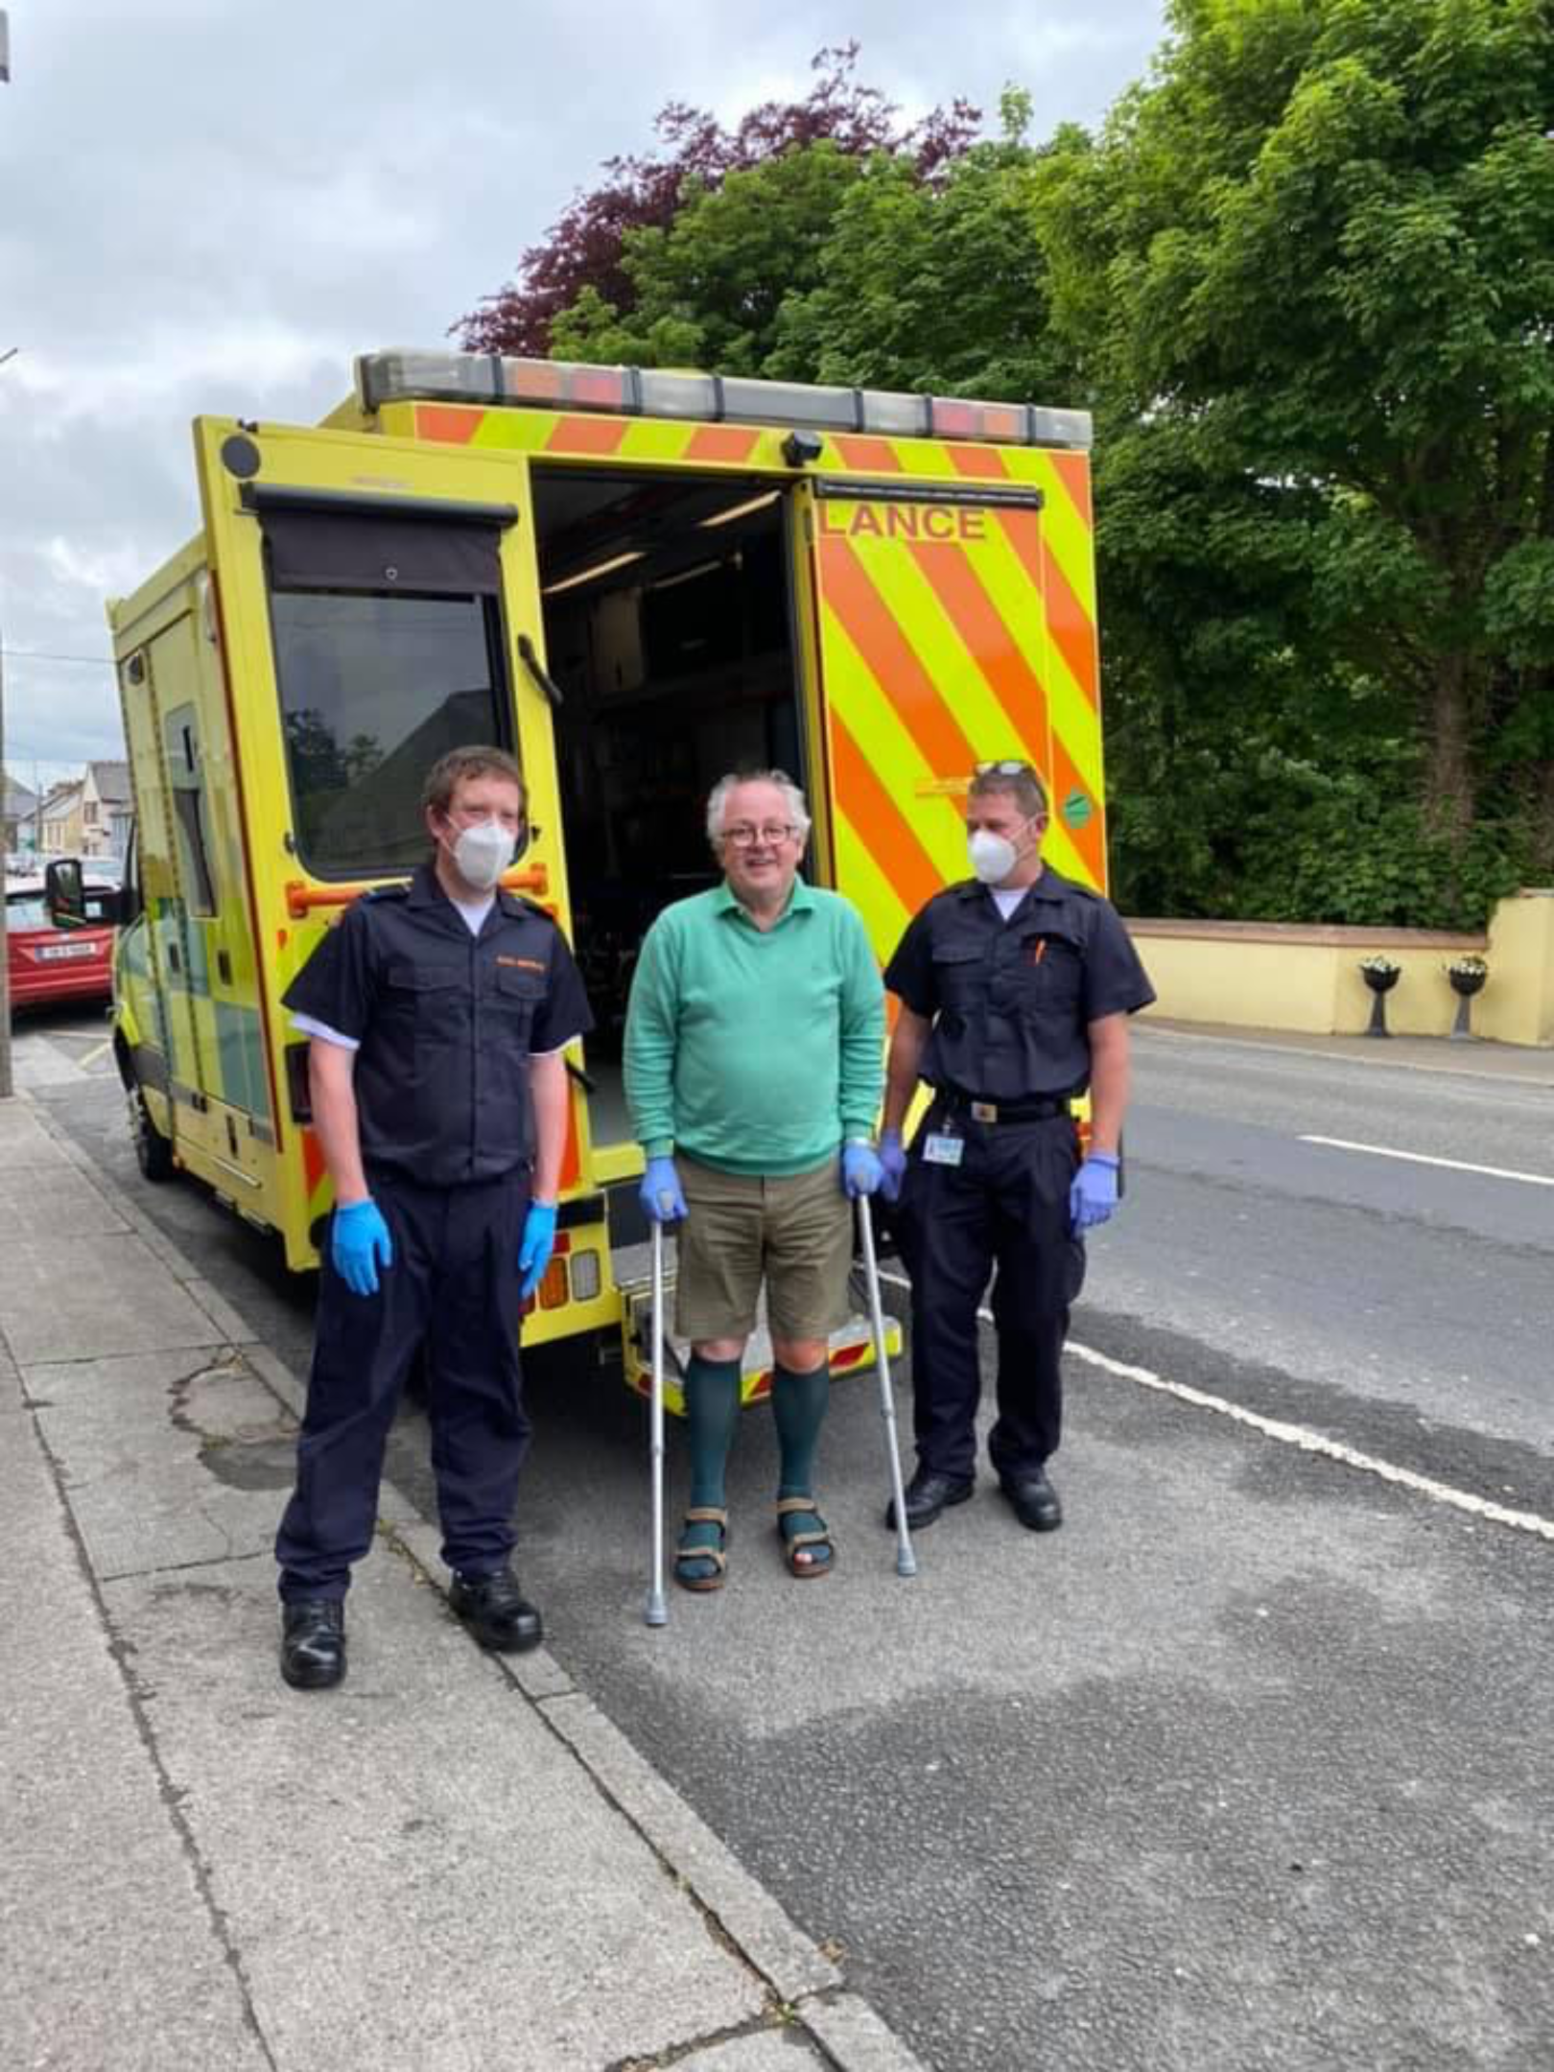
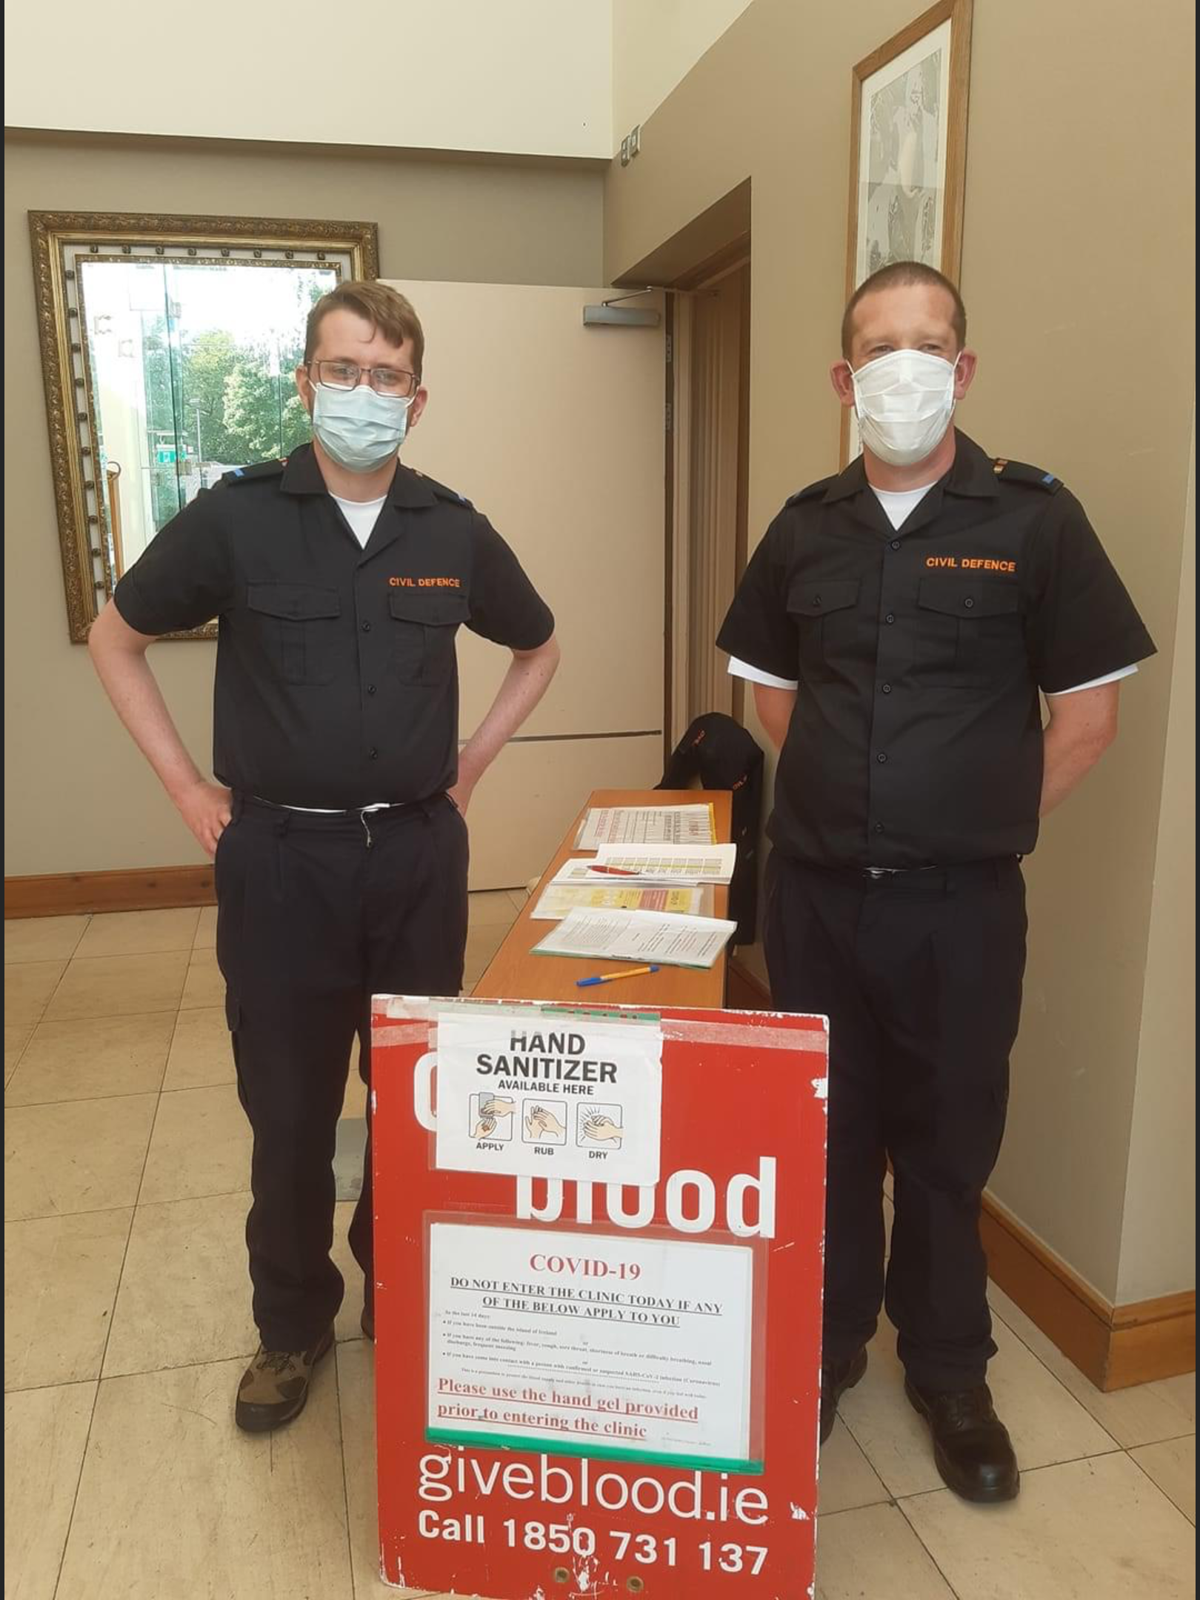
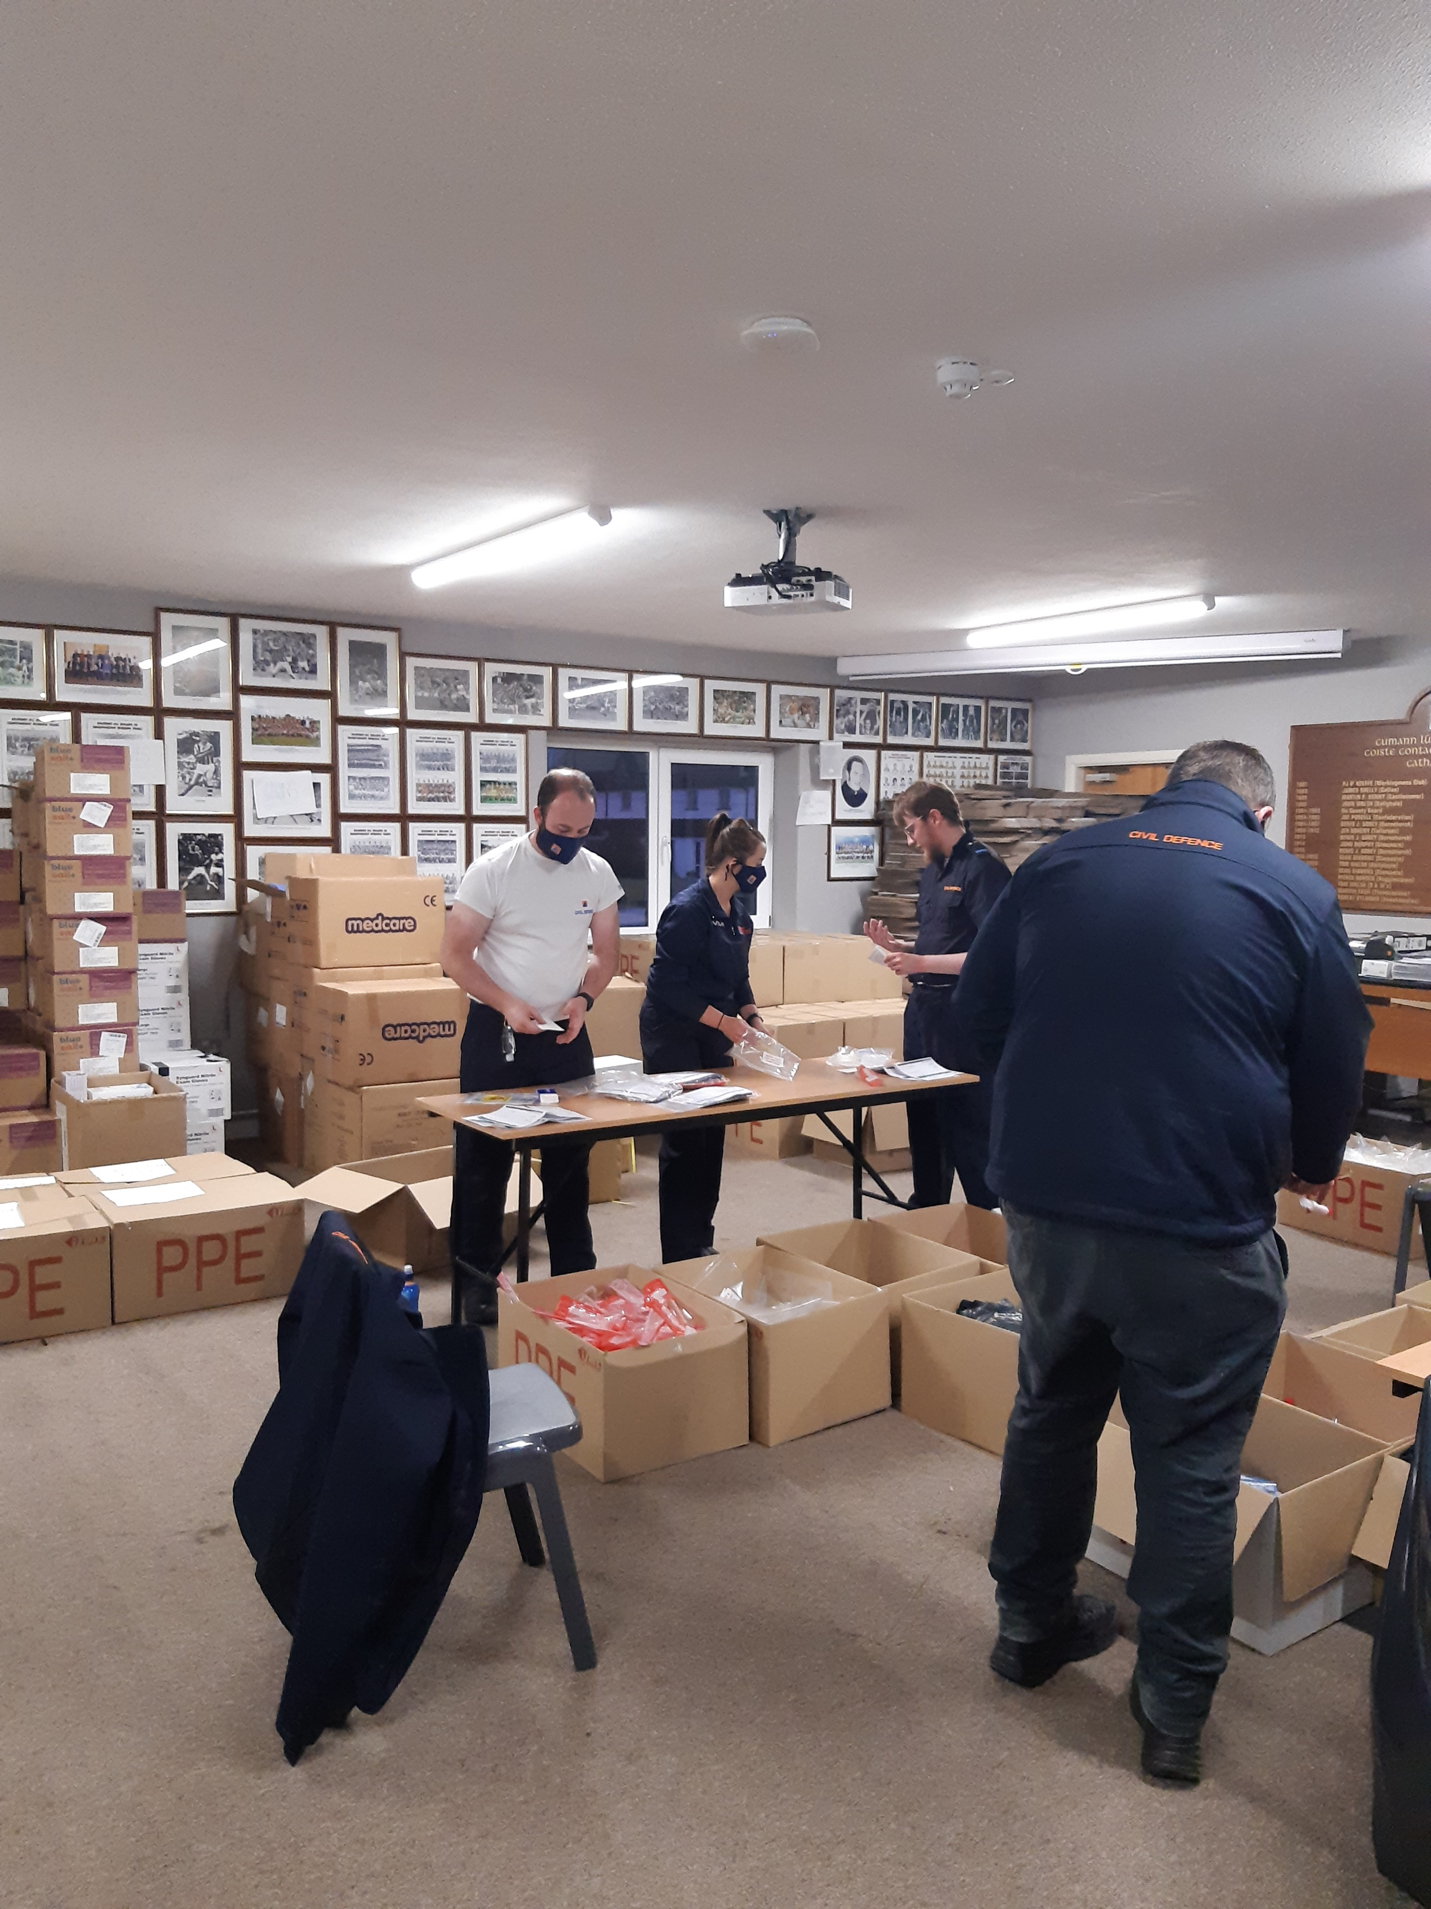
Packed and Delivered
340 care boxes, toys for
children with disabilities
Sanitizing packs for vulnerable
Families, hospital bags.
Unpacked Covid test kits
Several days per week Aug-Dec
100 medical transports
40 long distance
5 weeks of administrative
duties with for the
Irish Blood transfusion Service

Slide 10
Funding
2020
Dept of Defence grant 70% Max of 90K
LA must contribute further 30% on top of grant
2020 Kilkenny LA committed €72,000
Adopted budget €154,600
Covers all running costs- Salary, rent of premises, training, maintenance etc.
Additional Funding from Dept – €44,400 for Jeep/inflatable tent
Total spend 2020 = €199,000

Slide 11
Funding cont:
2021
Adopted budget €189,000
Dept have committed extra funding for F/T Assistant Civil Defence Officer (grade 4) (Recruitment Feb 2021)
LA committed €72,000
Loss:
Rent assistance from Dept. of €5000 being halved in 2021 and will cease in 2022
Full €23000 rent to be paid from CD budget
Needs:
Dedicated premises for Civil Defence
Premises suitable for vehicle/equipment storage – not for training
Dept of Defence contribution to permanent premises aprox €25K P/A over 5 years

Slide 12
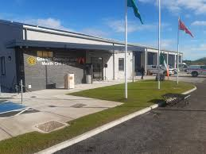
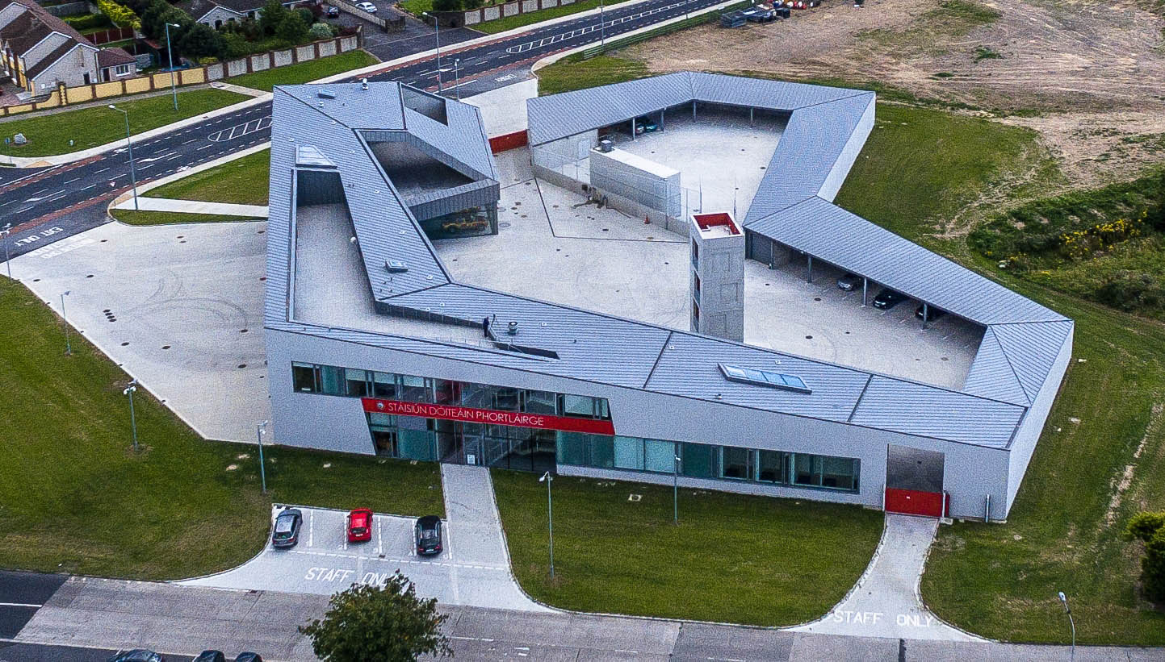
Future Plans include:
Drone Team
4x4 Jeep Ambulance Conversion – Dormant accounts fund €35K grant for purchase of vehicle -Conversion costs €25K – sale of older vehicles €14K
Grow Volunteer base to 50 volunteers
Dedicated Building for Civil Defence
Waterford Civil Defence
West Meath Civil Defence Opened 2020

Slide 13
Thank you for your time
Question’s?

